Slide 1

Transistor Transistor Logic (TTL)
CSE 211 DEPT
Lecturer Uzma Hasan, CSE department

Slide 2
Transistor-Transistor Logic(TTL)
Transistor–transistor logic (TTL) is a logic family built from bipolar junction transistors
Evolved in around 1960
Till now most successful logic family
Modified version of the DTL circuit
Diode D1 and D2 of DTL are replaced by emitter-base junction of T1 and collector-base junction (of T1 & T2) respectively
To overcome slow operation of DTL, TTL was developed
Propagation delay is 1/10th of DTL circuit
Power dissipation is also improved than DTL
TTL inputs are the emitters of a bipolar transistor (multi-emitter transistor)
In N-input TTL circuit, there will be N no. of emitters in the multi emitter input transistor
TTL is used in SSI and MSI
By using TTL, we can design a basic NAND, NOR, etc logic gates

Slide 3
Implementation / TYPEs of TTL
Fundamental TTL gate
TTL with a "totem-pole" or active pull up output
TTL with an open collector configuration (X)
TTL with a tri-state logic or 3 state output (High impedance gate)(X)
Schottky TTL(X)

Slide 4
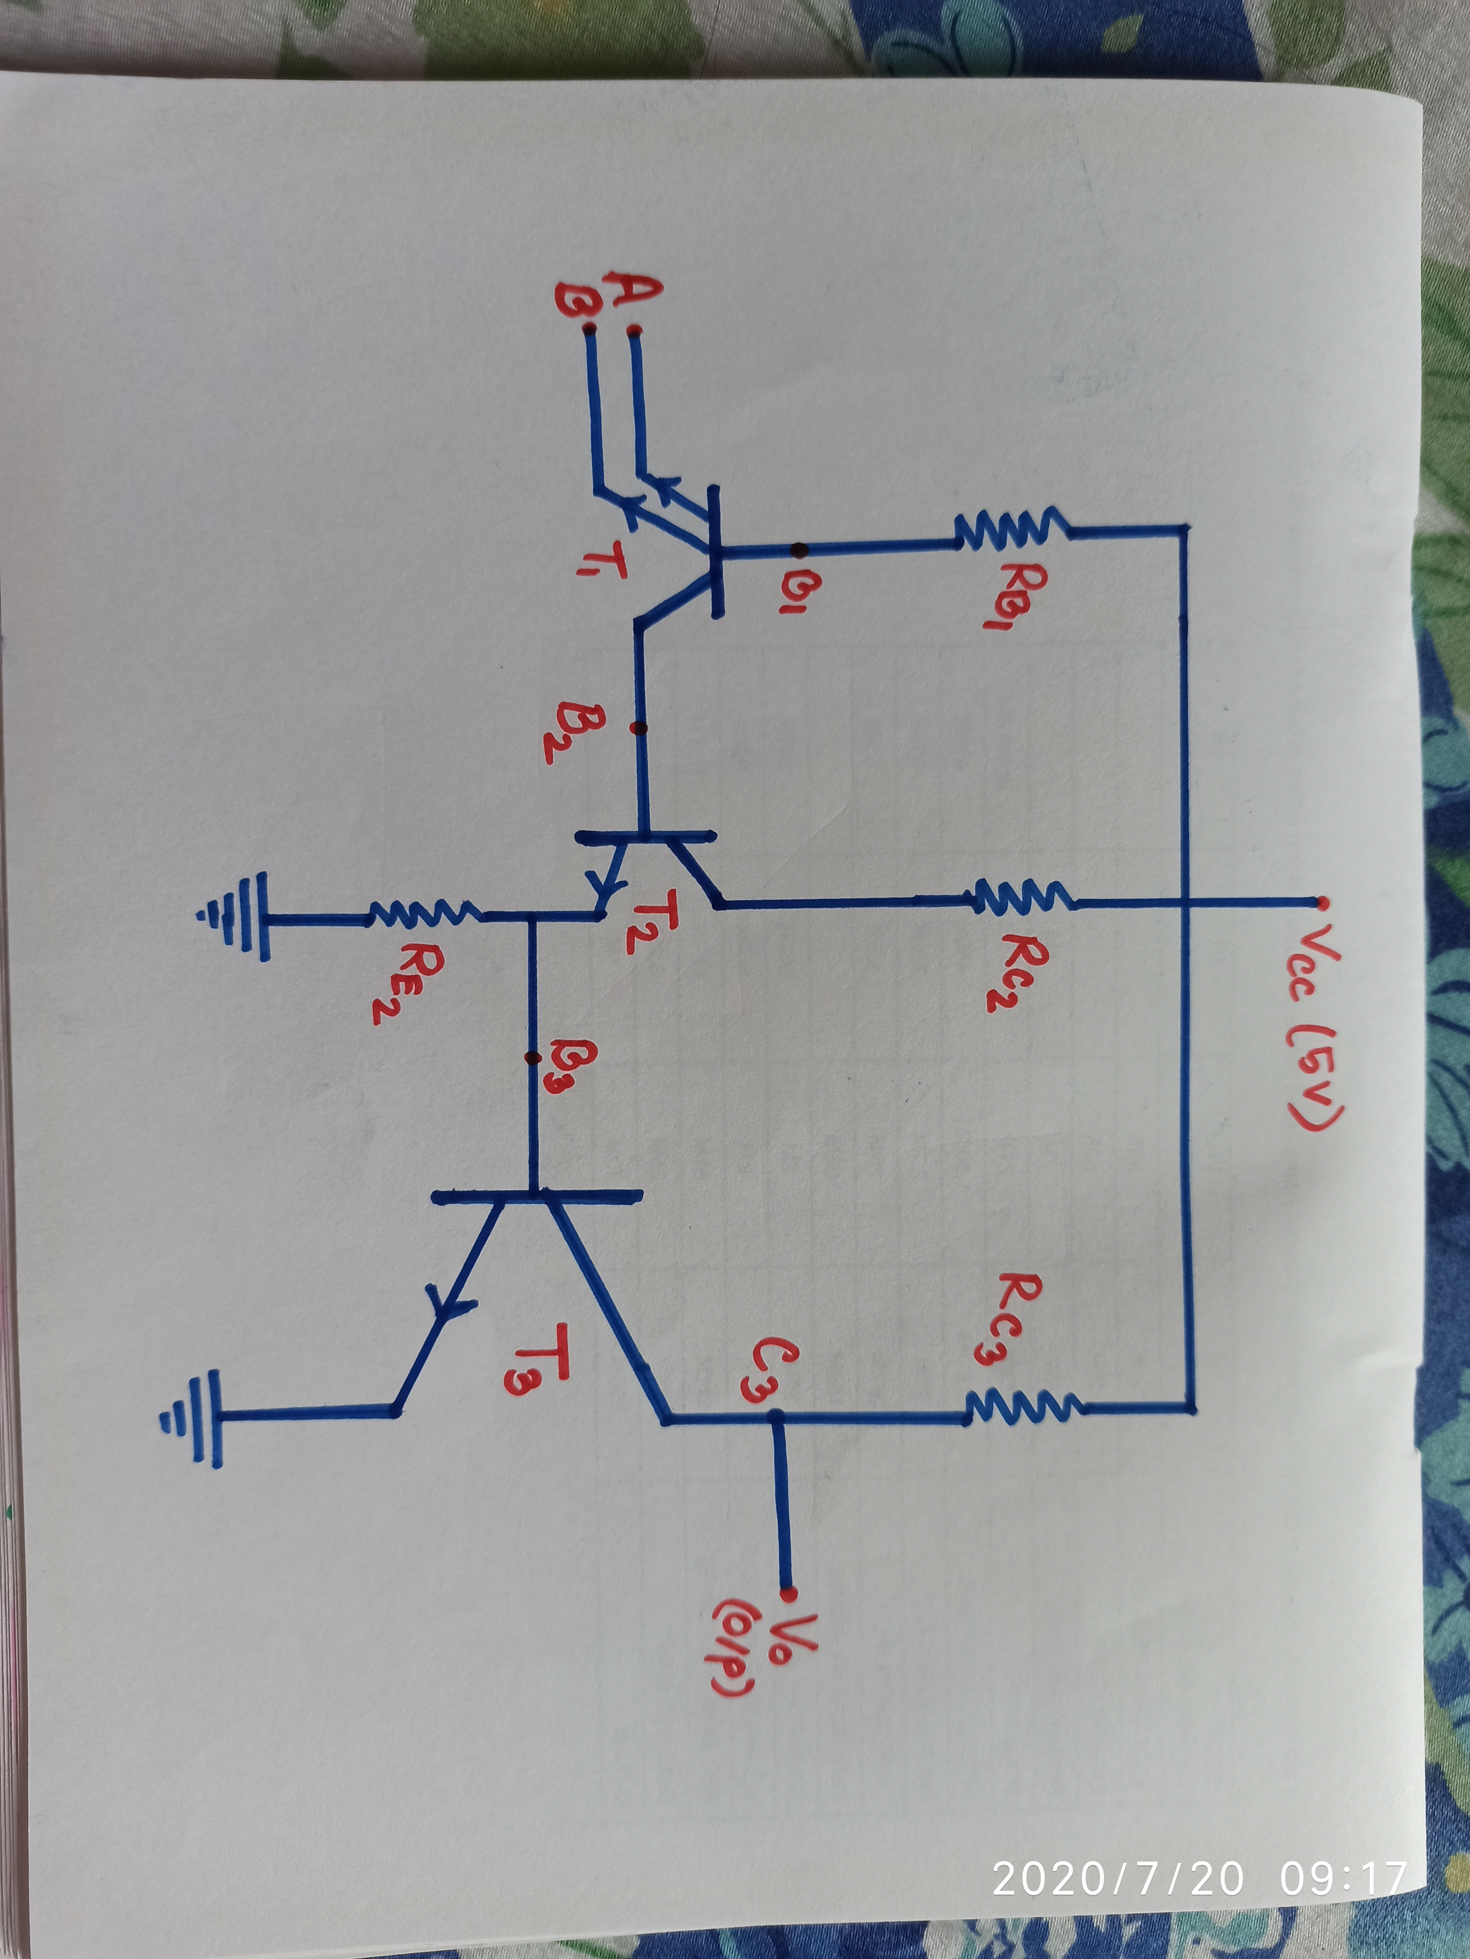
Fundamental Transistor Transistor Logic(TTL)
Figure : 2-input TTL NAND gate

Slide 5
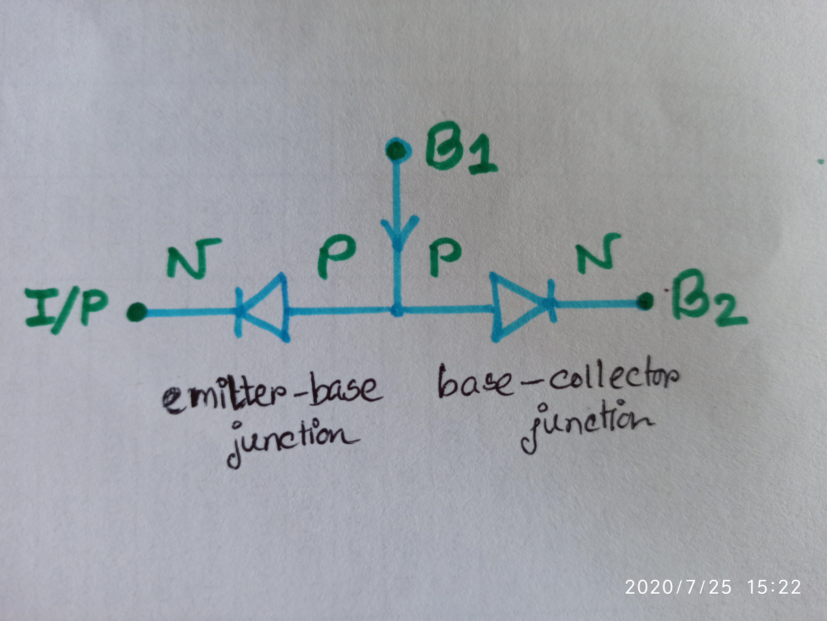
Fundamental TTL operation
CASE 1: (At least 1 input is 0)
A = 0 or B = 0 or A=B=0
For the corresponding input, that Emitter-Base junction of T1 is “Forward Biased”
(Short circuit)
So current from Vcc flows through that diode (EB junction) towards the input
Hence, the base-collector junction of T1 is “Reverse-biased” as no current flows through it
T1 is therefore at “ON” state, where EB junction forward-biased and BC junction reversed bias
That is T1 transistor is working in the “Active” region
Thus as all the current from Vcc flows out towards the input, sufficient voltage does not reach at the base of T2. For which T2 is OFF and it’s emitter current is 0
Thus no sufficient voltage also at the base of T3 and so T3 is OFF (Open circuit)
Hence Vout or Y get connected to Vcc that is Vo = HIGH or 1
A | B | Y
0 | 0 | 1
0 | 1 | 1
1 | 0 | 1
1 | 1 | 0
Fig: Equivalent ckt of T1

Slide 6
Fundamental TTL operation
A | B | Y
0 | 0 | 1
0 | 1 | 1
1 | 0 | 1
1 | 1 | 0
CASE 2 (All inputs are 1 or HIGH):
A = 1 and B = 1
For the corresponding inputs, Emitter-Base junctions of T1 is “Reverse Biased” (Open ckt)
So current from Vcc flows through that base-collector junction of T1 to the base of T2
In this case, the BC junction of T1 is forward-biased and EB junction of T1 is reversed bias
As sufficient voltage is available at the base of T2 this time, so T2 is ON
So IE2 flows to the base of T3 and turns it ON (i.e short ckt created)
Vo will be thus connected to GND through the short ckt
That means Vo = LOW or 0
Fig : Equivalent ckt of T1

Slide 7
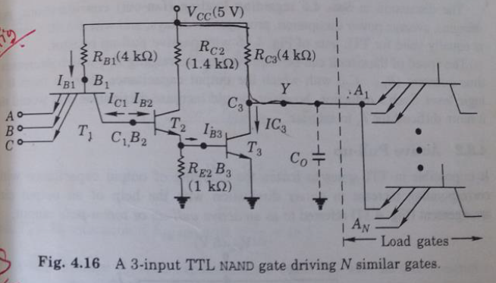
Problems with basic ttl circuit
Capacitive load in the output:
The capacitance of output transistor T3, capacitance of input terminals of the load gates connected to output Y and stray wiring capacitance combinedly makes the capacitive load at the output side.
If T3=OFF (Open Circuit), the capacitor gets charged through output Y connected to Vcc.
For this charging, a delay occurs in the circuit that is measured by RC (time constant). So to reduce the value of RC, we have to reduce the output resistance Rc3 which will further reduce the propagation delay
But if Rc3 is decreased, then when T3 = ON , then Ic3 increases ( I = V/R ) so power dissipation is high and also due to increase in saturation current Ic, we need to apply greater base current at the base of T3 when it goes to saturation
Thus two conflicting situation arises:
1. When T3 = OFF , we need lower value of the collector resistance Rc
2. When T3 = ON , a higher value of the collector resistance Rc is expected

Slide 8
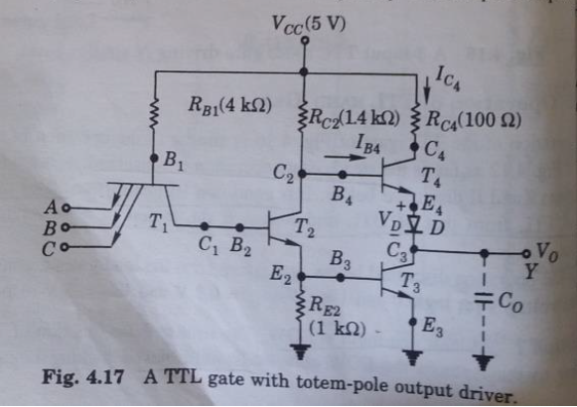
active pull up output (TTL)

Slide 9
active pull up output (TTL)
The problem of propagation delay due to charging of the output capacitance in a basic TTL circuit can be resolved using an active pull up or totem pole output configuration (both have the same meaning)
That is, in TTL gates it is possible to hasten the charging of output capacitance without corresponding increase in the saturation collector current (power dissipation) with the help of an output arrangement referred to as active pull-up or totem-pole output (see fig in previous slide)
The configuration is said active pull-up because it is made of a transistor (T4) and a diode (D) both of which are active devices ( A current or voltage controlled device is an active device, e.g: BJT, FET, etc ).
Pull up generally referred in case when an open circuit (T3) occurs, we see that output gets connected to Vcc. Actually, there the output’s voltage Vo is pulled up to the level of Vcc
T4, D and T3 altogether is sometimes referred as totem-pole output configuration
Here when T2 will keep T3 and T4 in either ON/OFF state
That is when T2 is ON, LOW input goes to T4’s base. So T4 is OFF and HIGH input goes to T3’s base so T3 is ON. And vice versa happens when T2 is OFF. Details is described in upcoming slides.
Here Rc4 = 100 ohms( very low resistance ) only which was 4 kilo ohms in the basic TTL gate ckt

Slide 10
Basic operation of active pull up TTL
A | B | Y
0 | 0 | 1
0 | 1 | 1
1 | 0 | 1
1 | 1 | 0
CASE 1: (At least 1 input is 0)
When any input is LOW, for that corresponding input, that Emitter-Base junction of T1 is “Forward Biased” (Short circuit)
So current from Vcc flows through that diode (EB junction) towards the input
In this case, available voltage at B1 = 0.9V ( 0.2V for the LOW input provided at any of the input terminals and 0.7V as the diode is conducting)
But required minimum voltage at B2 to turn on T2 and T3 is VB2 = VBE2 + VBE3
= 0.5 + 0. 5 = 1 V (Cut in voltage of transistor is 0.5 V)
As this much voltage is not available in this case, so T2 and T3 remains OFF.
So to summarize, T1 is in active region where it’s EB junction forward biased and BC junction reverse biased. T2 = OFF and T3 = OFF as point B2 does not have sufficient voltage to turn on T2 and T3
As T2 is OFF (open ckt), and resistance R2 is sufficiently low, so enough voltage from Vcc can pass to the base of T4 to turn it ON.
Therefore T4 is ON now, so it will turn ON diode D also
So Vo will be connected to Vcc and the output capacitor will be now charged with much lower delay than earlier as value of RC will be reduced ( because R4 is only 100 ohms now)
Finally Vo = Vcc – Vcutin (T4) – Vcutin (D) = 5 – 0.5 – 0.6 = 3.9 V (HIGH volt as > 3.7 volt )

Slide 11
Basic operation of active pull up TTL
A | B | Y
0 | 0 | 1
0 | 1 | 1
1 | 0 | 1
1 | 1 | 0
CASE 2: (All inputs are 1 or HIGH):
A = 1 and B = 1
For the corresponding inputs, Emitter-Base junctions of T1 is “Reverse Biased” (Open ckt)
So current from Vcc flows through that base-collector junction of T1 to the base of T2
In this case, the BC junction of T1 is forward-biased and EB junctions of T1 are reversed bias
As sufficient voltage flows to the base of T2, so T2 is ON
When T2 is ON, IE2 flows to the base of T3 and turns it ON (i.e short ckt created)
Vo will be thus connected to GND through the short ckt i.e Vo = LOW
In this case, voltage at B4 = VCE2 (sat) + VBE3 (sat) = 0.2+0.8= 1 V (As T2 and T3 is ON)
But to turn ON T4, minimum voltage required at B4 = VBE4 + VD = 0.5 + 0.6 (cut-in voltages) = 1.1 V
As available voltage at B4 is less than the minimum required voltage, so T4 remains OFF(Open ckt) in this case and thus creates a very high resistance (Open ckt) which fulfills our requirement of high resistance when T3 is ON (as higher resistance will allow smaller current Ic(sat) value)

Slide 12
Summary of Active pull-up
Thus active pull-up configuration was needed for the capacitive load at the output of TTL gate
When T3 is ON, active pull-up configuration offers HIGH impedance by keeping T4 OFF
And when T3 is OFF, it offers very LOW impedance as required for reducing propagation delay
Thus in this way it removes the conflicts arising in the basic TTL gate structure.

Slide 13
Practice problems
** Must Do Exercise Problem Numbers:
8.2, 8.3, 8.4, 8.5, 8.6, 8.7 and 8.8 from (Chapter 8 - Digital Systems Principles and Applications (8th edition) by Ronald J. Tocci)
** Necessary datasheet or table will be given during the exam.

Slide 14
references
**Class recordings and ppt lectures
**Books:
Chapter 4 - “Modern Digital Electronics” (For theoretical part only)
Chapter 8 - Digital Systems Principles and Applications (Only for math problems)
**For further clarification, you can go through these Youtube lessons:
Basic TTL: https://www.youtube.com/watch?v=exM_4Vbsxl4&t=163s
Active pull-up output(TTL): https://www.youtube.com/watch?v=J9rHX-lZxB8

Slide 15
Thankyou

